Slide 1
cubical directed homotopy
Sanjeevi Krishnan
CMU HoTT Seminar 03/01/24
Notes:
I’d like to talk a bit about a general area that I’m interested in, called directed algebraic topology. While it’s a relatively recent variant of algebraic topology, it’s motivation is close to the roots of the subject in understanding complex systems. For example, Poincare was interested in classifying qualitative behavior in a dynamical system by computing topological invariants on state spaces.

Slide 2
I. homotopy theories of 1-categories
Notes:
Like other variants of algebraic topology (think equivariant or parametrized), directed algebraic topology is the classification of spaces with some extra structure found in any state space. We’ll begin by motivating that structure in understanding real-world complex systems.

Slide 3
category theory
THM
There exists a model structure on Cat in which ...
  .... weak equivalences are the categorical equivalences
  .... cofibrations are those functors that are injective on objects
[Joyal and Tierney, 1991]

Slide 4
classical homotopy
THM
There exists a model structure on Cat whose weak equivalences are those functors that induce classical weak equivalences between nerves
[Thomason, 1991]

Slide 5
directed homotopy
DEF
A directed equivalence between small categories is a functor which is an isomorphism up to zig-zags of natural transformations.
PROP
Cat is a Λ-cofibration category.
[Minian, 2002]

Slide 6
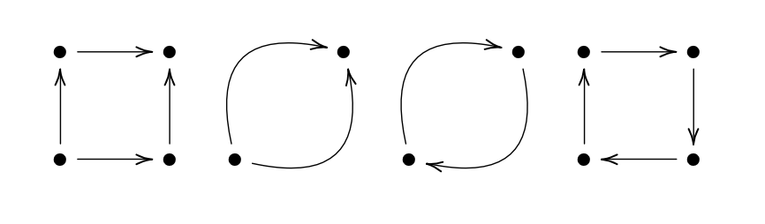
comparison of homotopy theories
groupoid/Thomason type
directed types
categorical types
Notes:
This homotopy extension property holds for more general subspaces. In this example, our subspace consists of two pieces. This example is notable because ….

Slide 7
an island of technical difficulties
categorical
Goubault, et al.
2007
Grandis
2007
Minian
2002
Hoff
1974
classical

Slide 8
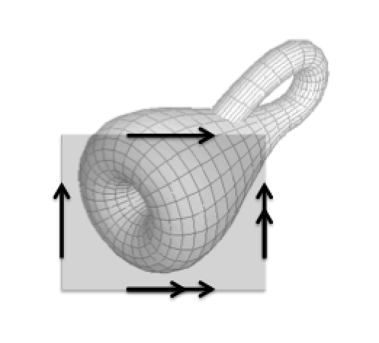
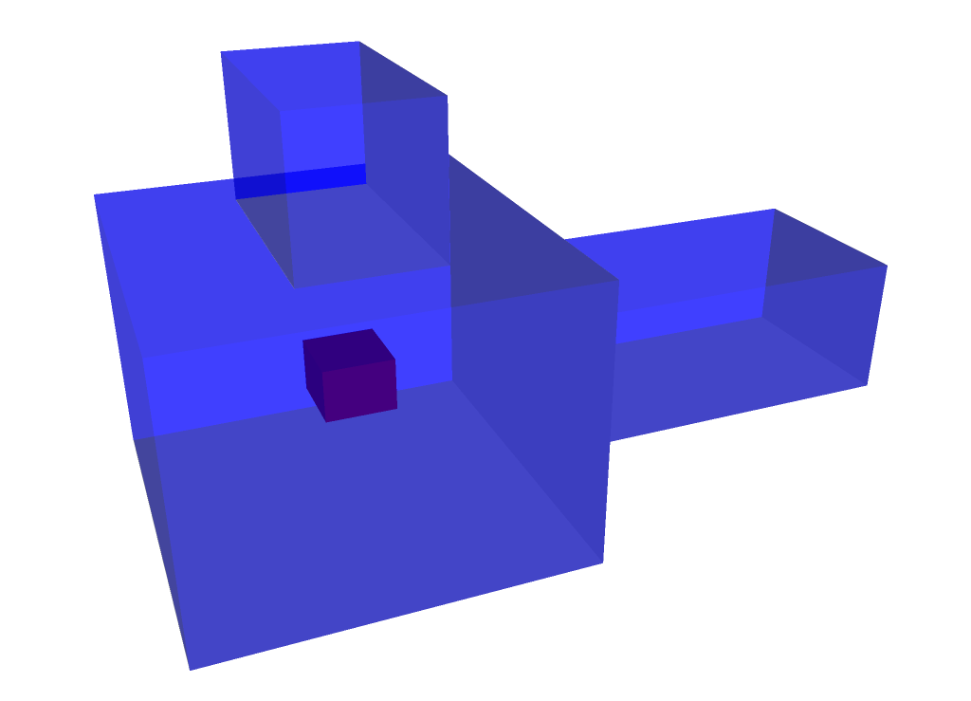
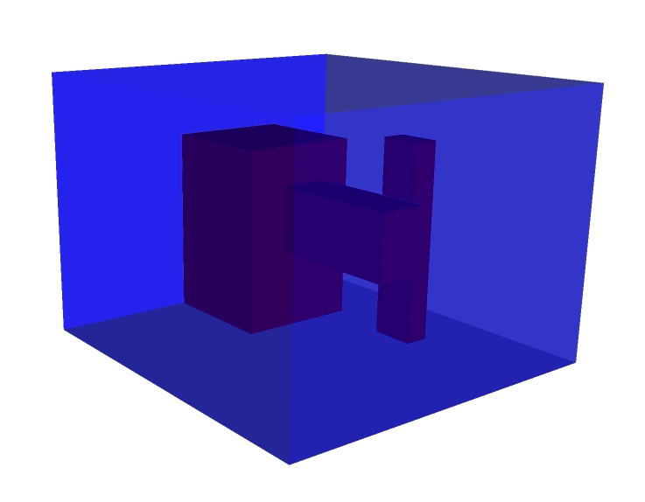
II. directed topology
Notes:
Like other variants of algebraic topology (think equivariant or parametrized), directed algebraic topology is the classification of spaces with some extra structure found in any state space. We’ll begin by motivating that structure in understanding real-world complex systems.

Slide 9
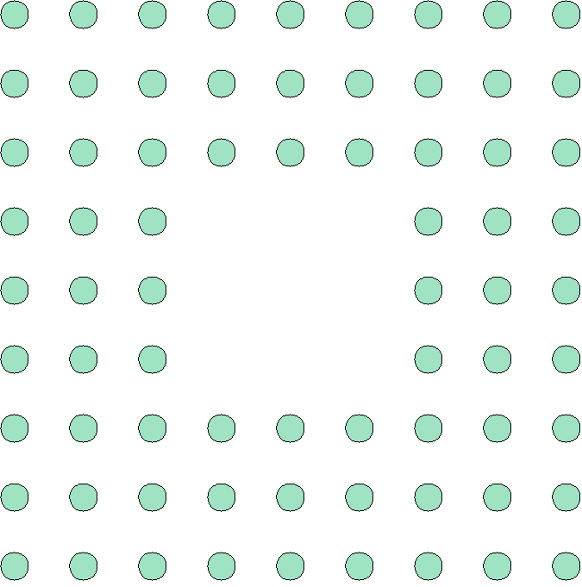
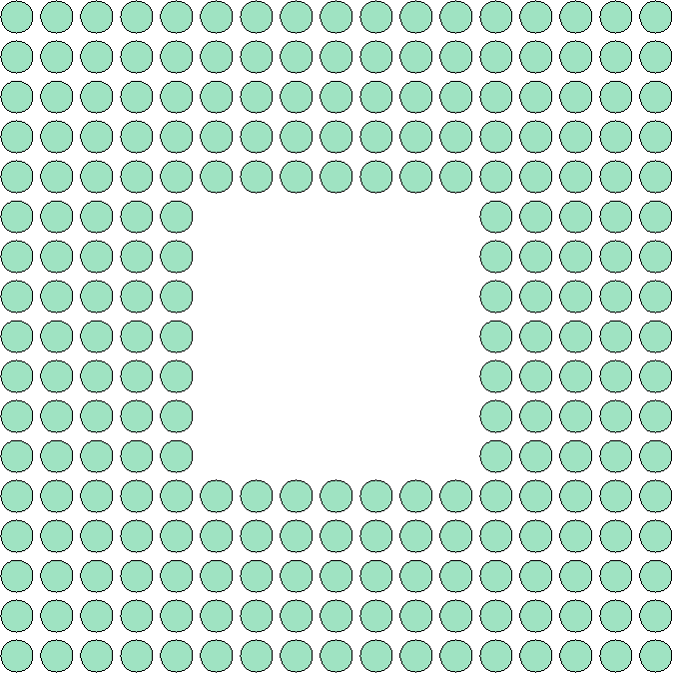
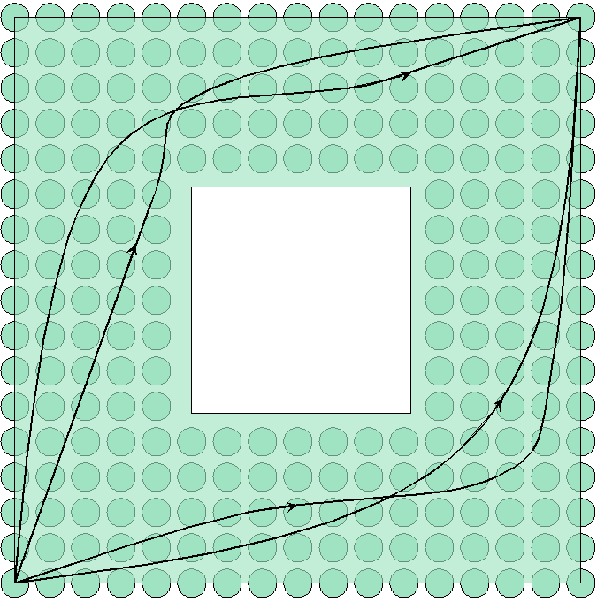
subdivision invariant state spaces
.
Pa.Va || Pa.Va
Pa.Va
Pa.Va

Slide 10

unpredictable behavior
5
8
9
40
START
LET X=4
LET X=X+4
PRINT X
START
LET X=1
LET X=5X
PRINT X
Notes:
This being modern times, our motivating example will be a system of concurrently executing computational processes accessing some shared resources, like memory. Without a global clock synchronizing our local processes, our individual processes can race each other at various relative speeds. Depending on the relative speeds of our individual processes, we can arrive at very different results.

Slide 11

directed paths as executions
stream maps from [0,1]
Notes:
We can visualize these different possible executions that our global system can take as paths on a state space. But these aren’t just any paths. These are paths on the state space that are monotone in each coordinate – after all, we can’t go backwards in time.

Slide 12
behavior up to homotopy
homotopies through paths in time
Paths homotopic through paths in time relative endpoints represent qualitatively equivalent behavior.
Notes:
If we go back to our original state space, we notice that slight perturbations of a directed space correspond to executions of a system that are essentially the same. In the above example, we can formalize those perturbations as directed homotopies, homotopies through dimaps.

Slide 13
more state spaces
some state spaces of 3 concurrent processes
Notes:
And b adding more processes, we increase the dimensions of our state spaces –to the point where systems of interest in the real world, whether natural or engineered, often have really high dimensions.

Slide 14
streams
[Krishnan, 2015]
Notes:
This homotopy extension property holds for more general subspaces. In this example, our subspace consists of two pieces. This example is notable because ….

Slide 15
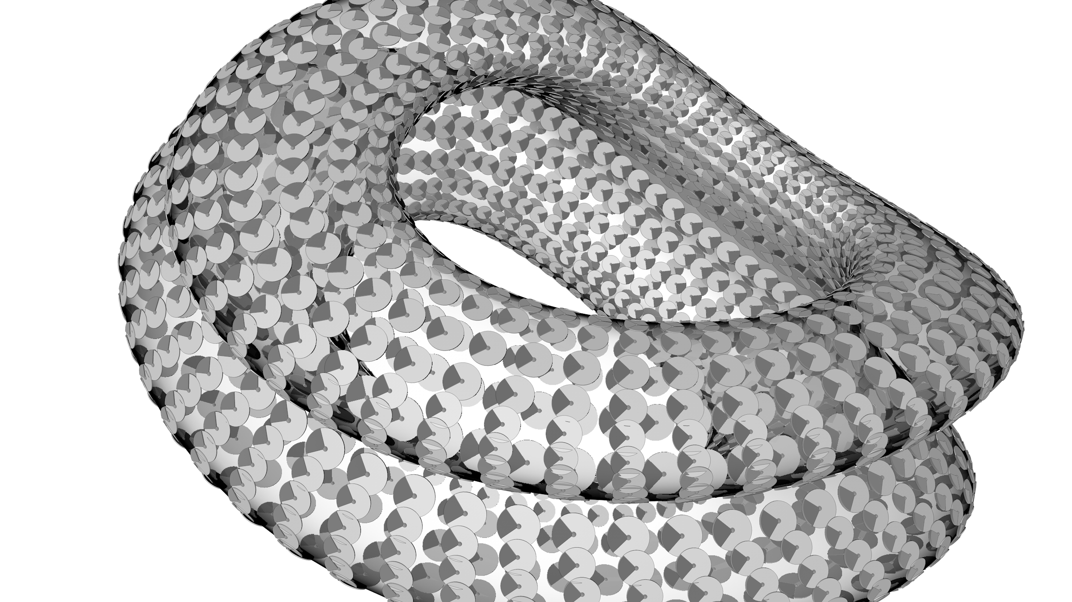
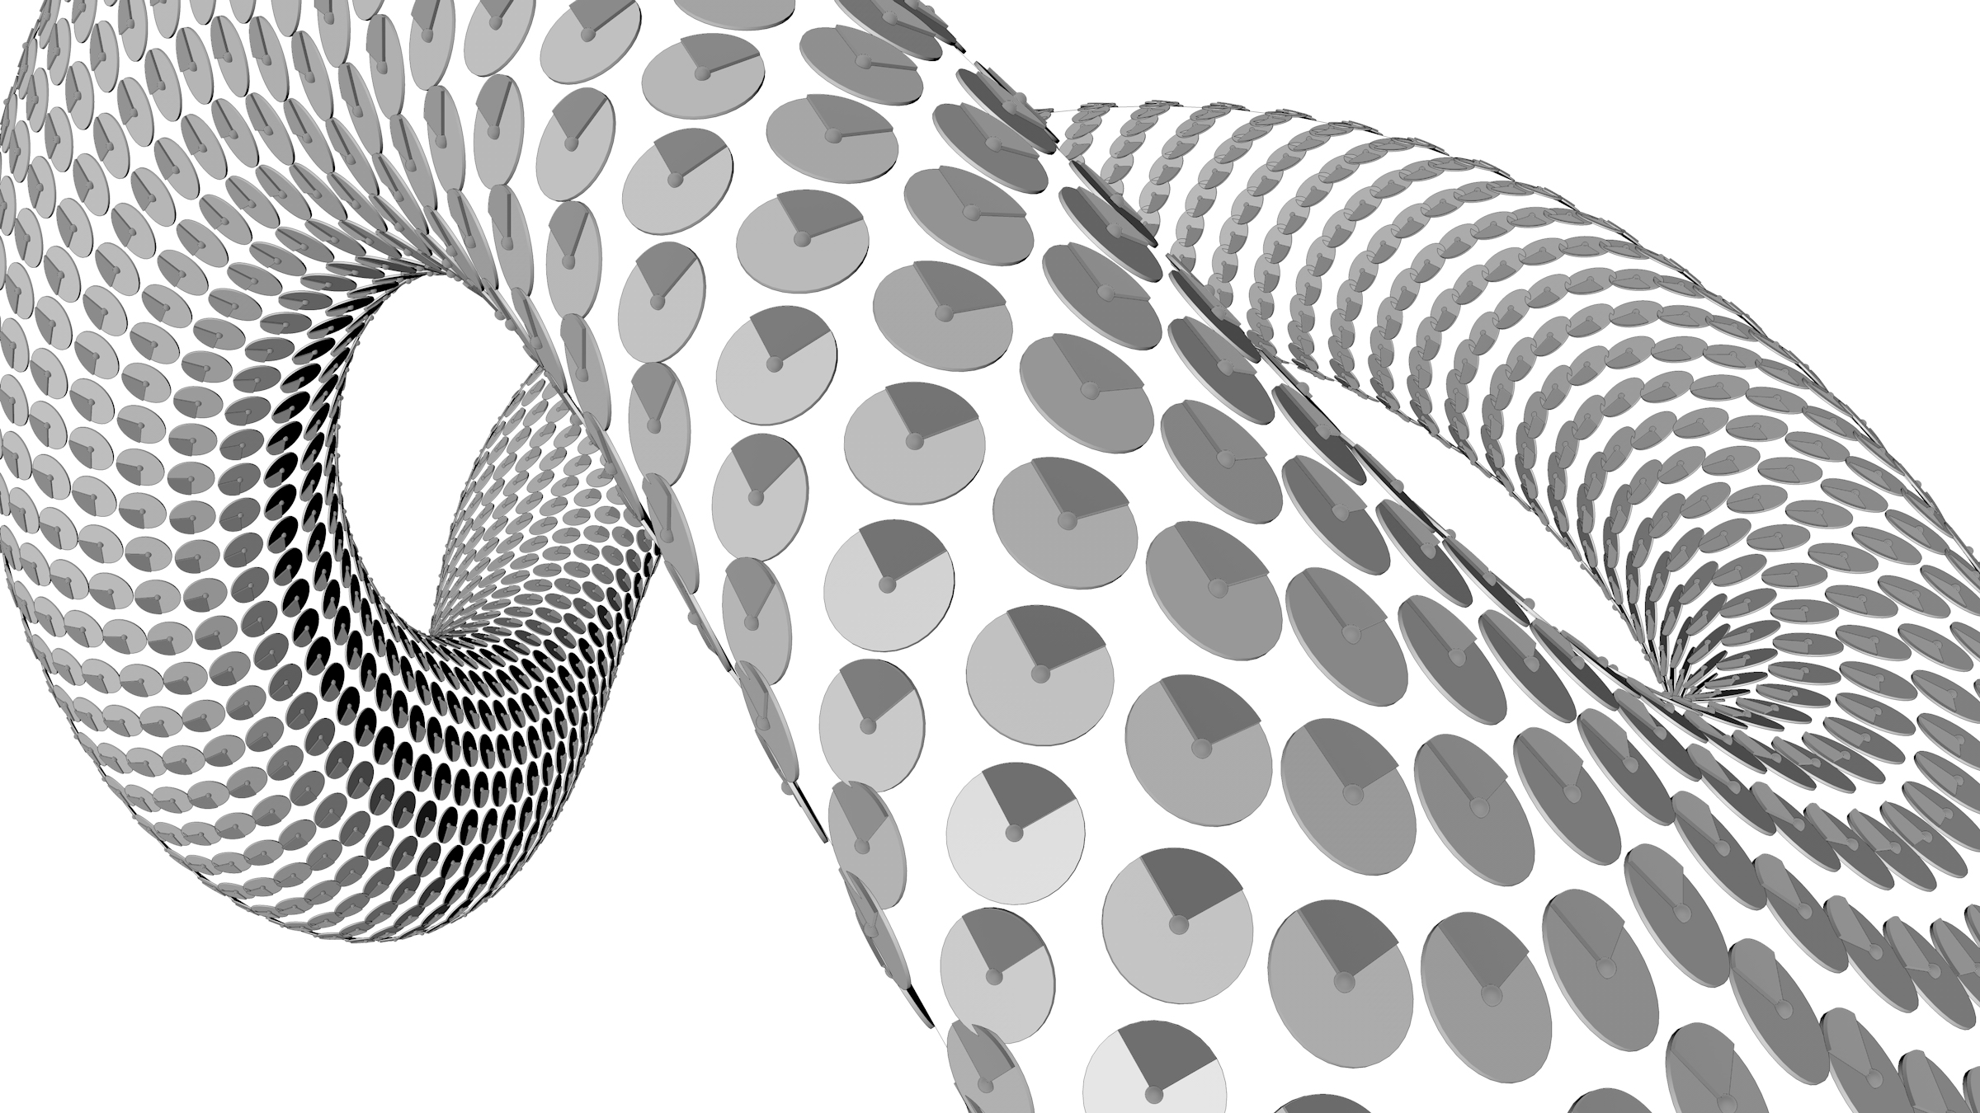
streams in nature
spacetime: open normal U gets assigned the causal order
Notes:
This homotopy extension property holds for more general subspaces. In this example, our subspace consists of two pieces. This example is notable because ….

Slide 16
streams in nature
THM
Every compact Hausdorff connected topological lattice X has the unique structure of a stream in which the preorder on X is the lattice order on X.
EG
topological simplices with lattice operations
EG
topological cubes with product orders
[Krishnan, 2015]
Notes:
This homotopy extension property holds for more general subspaces. In this example, our subspace consists of two pieces. This example is notable because ….

Slide 17
stream realizations
stream realization functor: left Kan extension
[Krishnan, 2015]
Notes:
This homotopy extension property holds for more general subspaces. In this example, our subspace consists of two pieces. This example is notable because ….

Slide 18
stream realizations
stream realization extends to presheaves over a small subcategory
[Krishnan, 2015]
Notes:
This homotopy extension property holds for more general subspaces. In this example, our subspace consists of two pieces. This example is notable because ….

Slide 19
streams in nature
EG
stream realizations of nerves of small categories
EG
more general homotopy colimits of dynamical systems
X
XxI where I is directed
Y
Y
Notes:
This homotopy extension property holds for more general subspaces. In this example, our subspace consists of two pieces. This example is notable because ….

Slide 20
directed homotopy equivalence
dihomotopy equivalence = stream map with inverse up to directed homotopy
state spaces of systems with similar qualitative features
Notes:
And once we have dihomotopies, we get a notion of equivalence between directed spaces – a dihomotopy equivalence. Dihomotopy equivalences preserve certain qualitative properties of a system.

Slide 21
directed homotopy types
homeomorphic but not dihomotopy equivalent
Notes:
Dihomotopy equivalence is strikingly different in nature than ordinary homotopy equivalence. Illustrated is an example of two locally preordered spaces, homeomorphic as spaces, which are nonetheless not dihomotopy equivalent.

Slide 22
directed homotopy types
contractible but not dicontractible
[L. Fajstrup, 2009]
Notes:
Here we have two spaces, contractible and also dicontractible. In fact, we’re tempted to say that like in homotopy theory, the obstructions to contractibility are the holes in various dimensions, as measured by homotopy or homology groups…. But something weirder is going on in the directed setting. We can attach cells without changing the contractibility of our space. But we can change the dicontractibility of the space.

Slide 23
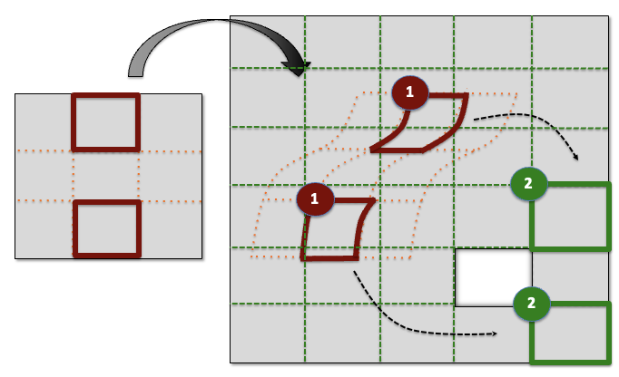
indecomposability of directed homotopy types
inclusion of cubes in an iterated subdivision of cubes almost never has the homotopy extension property
directed spaces do not decompose into directed homotopy colimits of simple cells
Notes:
This homotopy extension property holds for more general subspaces. In this example, our subspace consists of two pieces. This example is notable because ….

Slide 24
no known Whitehead Theorem
There is no known directed homotopy invariant π* such that
is an isomorphism if and only if f is a directed homotopy equivalence and π* is compactly supported, for all stream maps f between streams in nature.
Notes:
This homotopy extension property holds for more general subspaces. In this example, our subspace consists of two pieces. This example is notable because ….

Slide 25
fundamental questions
localization by cubical functions whose images under sing|-| are naïve combinatorial homotopy equivalences
localization by stream maps whose images under right adjoint to |-| are naïve combinatorial homotopy equivalences
When do localizations exist? When is there a bottom equivalence?
Notes:
This homotopy extension property holds for more general subspaces. In this example, our subspace consists of two pieces. This example is notable because ….

Slide 26
working category of cubes
minimal symmetric monoidal variant: cofaces, codegeneracies, coordinate permutations
THM
TFAE for a monotone function φ:[1]^{m}→[1]^{n}:
1. φ is a morphism in
2. φ is an interval-preserving lattice homomorphism
(between finite Boolean lattices)
cubical sets = cubical sets with symmetries = presheaves over
[Krishnan, 2015]
Notes:
This homotopy extension property holds for more general subspaces. In this example, our subspace consists of two pieces. This example is notable because ….

Slide 27
III. cubical sets
Notes:
Like other variants of algebraic topology (think equivariant or parametrized), directed algebraic topology is the classification of spaces with some extra structure found in any state space. We’ll begin by motivating that structure in understanding real-world complex systems.

Slide 28
examples
1
cubical nerves of small categories
2
singular cubical sets of streams
3
edge-oriented cubical complexes
[Krishnan, 2015]
Notes:
This homotopy extension property holds for more general subspaces. In this example, our subspace consists of two pieces. This example is notable because ….

Slide 29
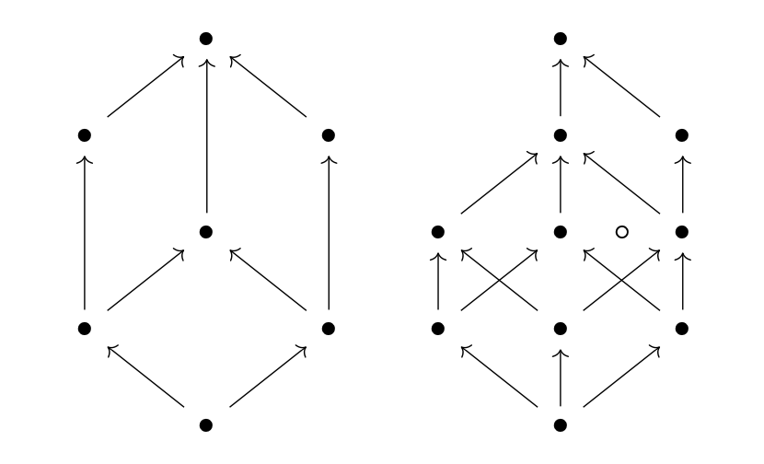
example: Boolean intervals
[P] = cubical set of interval-preserving monotone functions [1]^{n}→P
isomorphism classes of finite distributive meet-semilattices
isomorphism classes of finite rooted CAT(0) cubical complexes up to isometry
THM
[Ardila, Owen, Sullivant, 2012]
Notes:
This homotopy extension property holds for more general subspaces. In this example, our subspace consists of two pieces. This example is notable because ….

Slide 30
cubical homotopy theories
Doherty et. al
2020
higher categorical
directed
ψ is a weak equivalence iff |ψ| is a directed homotopy equivalence
Grandis
2008
Lucas
2016
test model structure
Notes:
This homotopy extension property holds for more general subspaces. In this example, our subspace consists of two pieces. This example is notable because ….

Slide 31
subdivisions
cocontinuous endofunctor sd on cSet with
Notes:
This homotopy extension property holds for more general subspaces. In this example, our subspace consists of two pieces. This example is notable because ….

Slide 32
convenient properties of subdivision
LEM
Fix a cubical set C. There exist dotted cubical functions making
commute and natural in subcubical sets S of sd⁴C that lie in the closed Star of a vertex.
LEM
There exist natural stream isomorphisms
[Krishnan, 2015]
Notes:
This homotopy extension property holds for more general subspaces. In this example, our subspace consists of two pieces. This example is notable because ….

Slide 33
cubical approximation
THM
Fix cubical sets A,B with A finite. For each stream map
f:|A|→|B|
f is directed homotopic to a stream map |A →B| after replacing A with sd^{k}A for k sufficiently large.
PROOF
After sufficiently many subdivisions, f maps cubes into stars.
Then f locally lifts to a directed cube.
Convex structure gives requisite homotopies.
1
2
3
[Krishnan, 2015]
Notes:
This homotopy extension property holds for more general subspaces. In this example, our subspace consists of two pieces. This example is notable because ….

Slide 34
IV. cubcats
Notes:
Like other variants of algebraic topology (think equivariant or parametrized), directed algebraic topology is the classification of spaces with some extra structure found in any state space. We’ll begin by motivating that structure in understanding real-world complex systems.

Slide 35
definition
cubcat = cubical set C admitting structure maps
where ex is right adjoint to sd
satisfying a compatibility condition
[Krishnan, 2023]
Notes:
This homotopy extension property holds for more general subspaces. In this example, our subspace consists of two pieces. This example is notable because ….

Slide 36
examples
THM
cubical nerves are cubcats
THM
singular cubical sets of streams are cubcats
THM
test fibrant cubical sets are cubically homotopy equivalent to cubcats
[Krishnan, 2023]
Notes:
This homotopy extension property holds for more general subspaces. In this example, our subspace consists of two pieces. This example is notable because ….

Slide 37
dictionary
test fibrant cubical sets
cubcats
eg: nerves of small groupoids
eg: nerves of small categories
every cubical set is test fibrant up to classical weak equivalence
every cubical set is a cubcat up to directed weak equivalence
for test fibrant B
for cubcats B
[Krishnan, 2023]
Notes:
This homotopy extension property holds for more general subspaces. In this example, our subspace consists of two pieces. This example is notable because ….

Slide 38
dictionary
test fibrant cubical sets
cubcats
eg: nerves of small groupoids
eg: nerves of small categories
every cubical set is test fibrant up to classical weak equivalence
every cubical set is a cubcat up to directed weak equivalence
for test fibrant B
for cubcats B
requires an analogue of Reedy cofibrant replacement
[Krishnan, 2023]
Notes:
This homotopy extension property holds for more general subspaces. In this example, our subspace consists of two pieces. This example is notable because ….

Slide 39
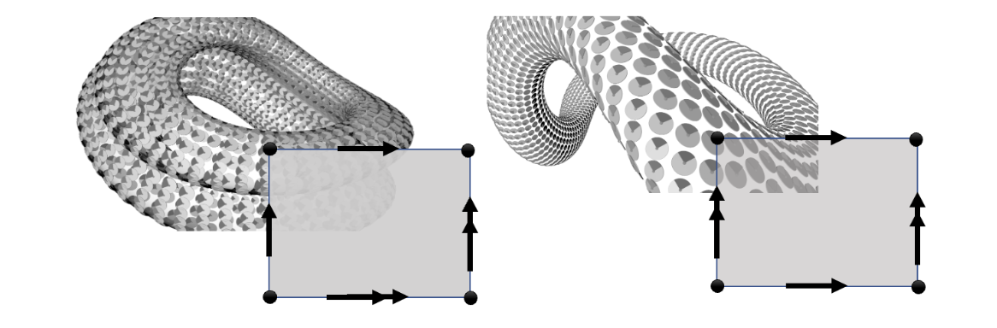
1-cohomology H¹(-;M)=[-,|BM|]
spacetime Klein bottle
spacetime torus
for cancellative commutative monoid coefficients M
[Krishnan, 2023]
Notes:
This homotopy extension property holds for more general subspaces. In this example, our subspace consists of two pieces. This example is notable because ….

Slide 40
V. big picture
Notes:
Like other variants of algebraic topology (think equivariant or parametrized), directed algebraic topology is the classification of spaces with some extra structure found in any state space. We’ll begin by motivating that structure in understanding real-world complex systems.

Slide 41
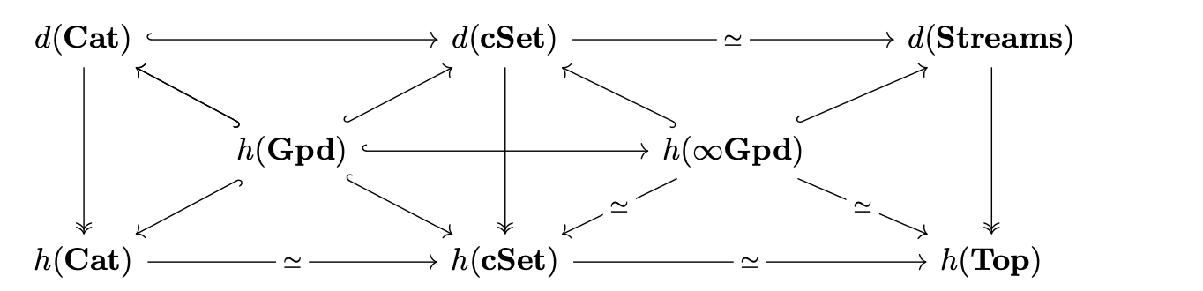
equivalences
test fibrant cubical sets
Directed homotopy theory both refines and extends classical homotopy theory.
[Krishnan, 2023]
Notes:
Research year Curtis proved this

Slide 42
future directions
1
type-theoretic model structures
2
higher order rewriting-based programming
Notes:
This homotopy extension property holds for more general subspaces. In this example, our subspace consists of two pieces. This example is notable because ….

Slide 43
type-theoretic model structure
There exists an “h-like” model structure on bicubical sets.
1
THEOREM: There exists a model structure on bicubical sets ccSet in which …
1. … the weak equivalences f are characterized by ccSet(X,f) a test weak equivalence of cubical sets
2. … the fibrations f are characterized by ccSet(X,f) a fibration of cubical sets
3. … the cofibrations are the injections that are degreewise coprojections
4. … fibrant objects include bicubical nerves of preordered groups (regarded as double categories)
Cubical approximation theorems show that |sing -| is a Quillen idempotent comonad.
2
CONJECTURE: we can apply Bousfield-Fridlander (to then get a type-theoretic model structure.)
3
me, 2015, 2021

Slide 44
I’m glad you asked...
Notes:
Like other variants of algebraic topology (think equivariant or parametrized), directed algebraic topology is the classification of spaces with some extra structure found in any state space. We’ll begin by motivating that structure in understanding real-world complex systems.

Slide 45

directed homotopy in software
Goubault
Notes:
These are part of first steps towards understanding algebraic and topological obstructions to strong dualities in optimization.

Slide 46
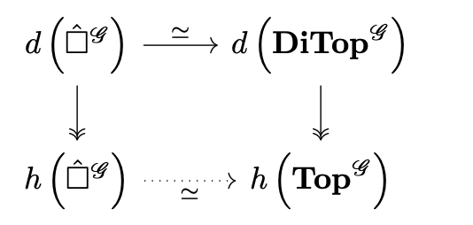
equivariant equivalence
naturality of cubical approximation gives equivariant equivalences
Notes:
Research year Curtis proved this

